Slide 2
Improving Employee Engagement
Grassroots
Link to Lean and Six Sigma
Spirit of Kaizen—Continuous improvement
Location –in the Gemba
where work takes place

Slide 3
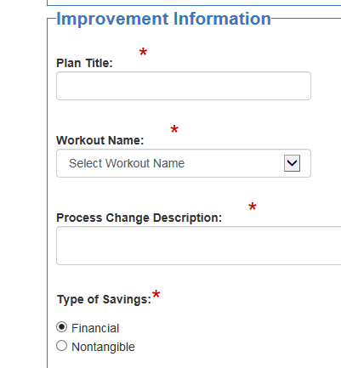
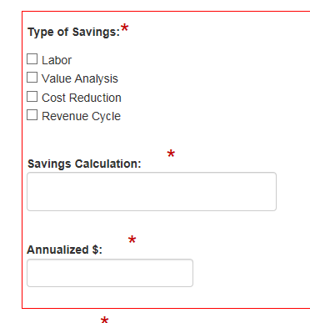
Leader Portal
Change is Good!

Slide 4
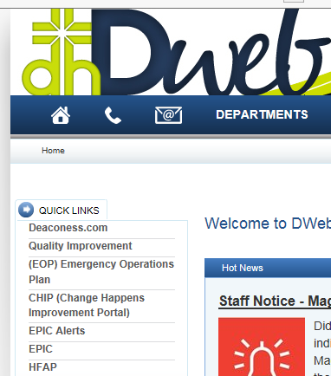
Employee Portal

Slide 5
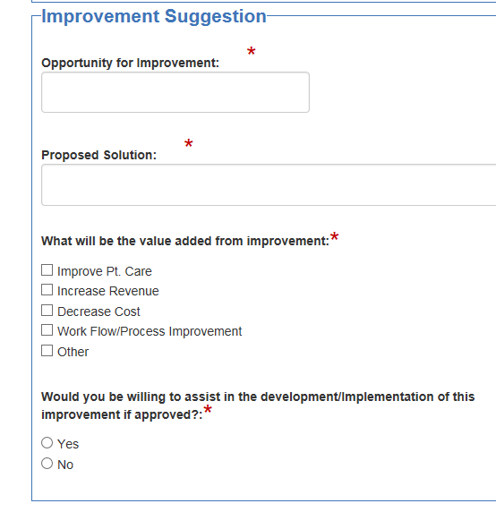
Employee Portal

Slide 6
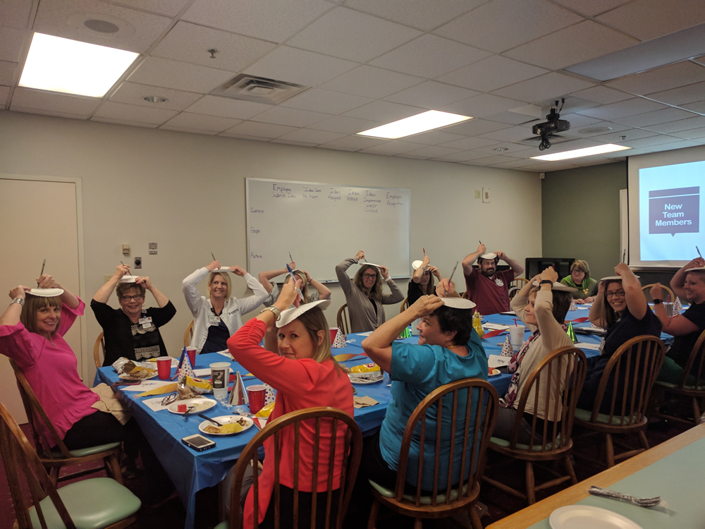
CHIP Idea Team

Slide 7
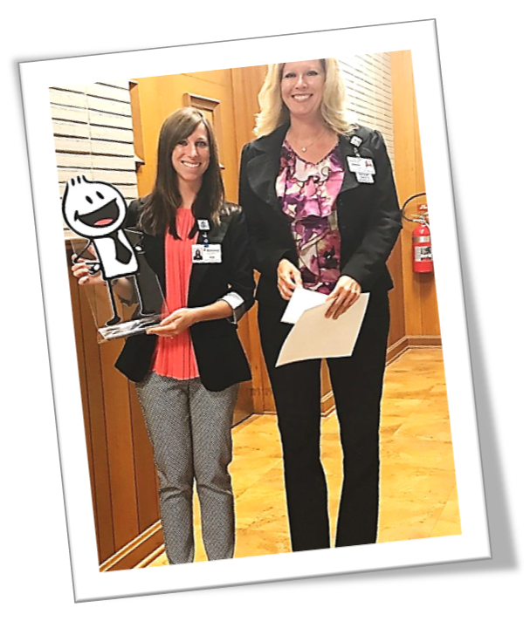
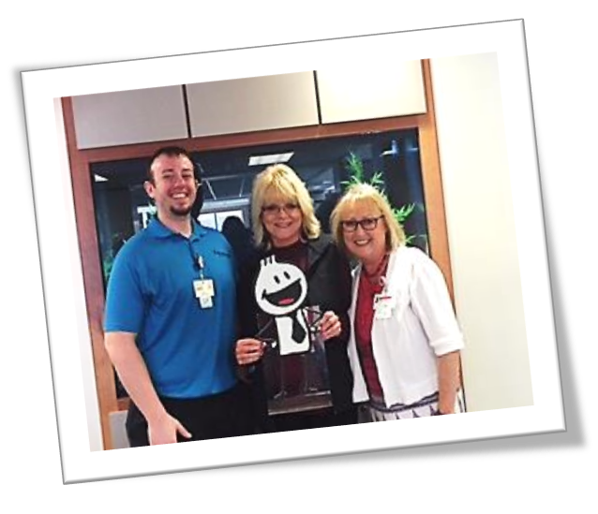
CHIP of the Month

Slide 8
Happy Birthday CHIP!

Slide 9
Deaconess Leaders
67 Leaders
885 changes
$3,005,307
Notes:
Where is the manager portal?

Slide 10
Deaconess
Employees

Slide 11
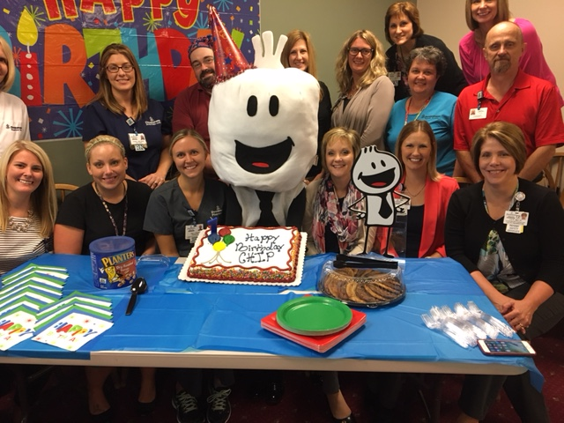
Meet CHIP!!

