Slide 1



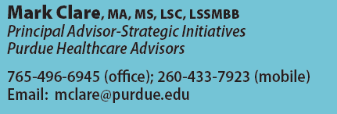
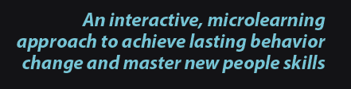
Adjunct Faculty at Northwestern University

Slide 2
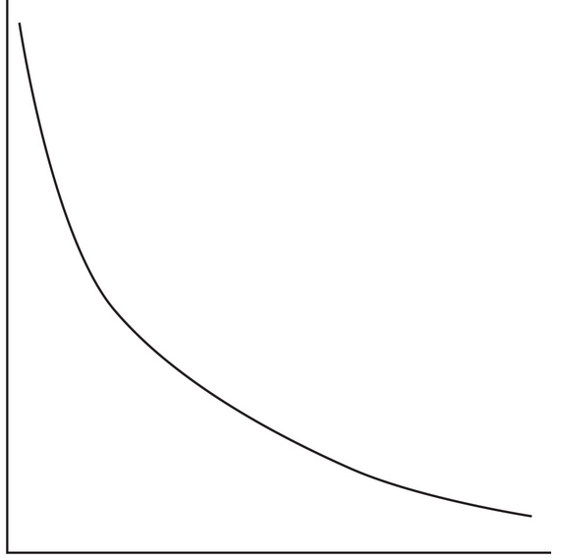
The General Problem
Soft Skill Training Impact
Happy!
Pass Quiz
Number of Participants
Exhibit new skills & behaviors
Achieve outcome
Impact or ROI

Slide 3
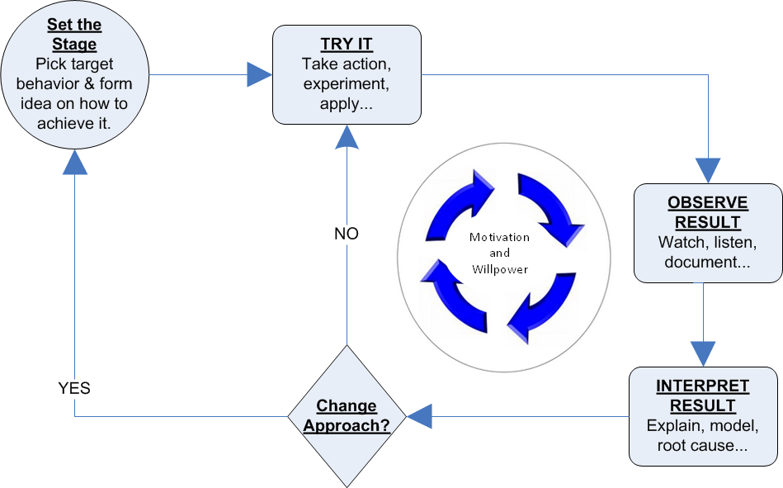
Study the Positive Deviance
Protocol Analysis
Break macro concepts and techniques into small, short experiments they can try in a real setting on a regular or daily basis
Natural born micro learners!
Learning from experience is the flywheel for behavior change

Slide 4
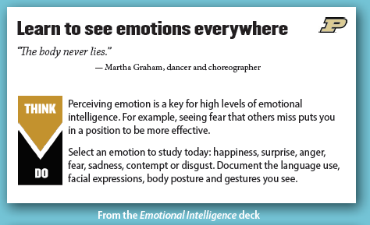
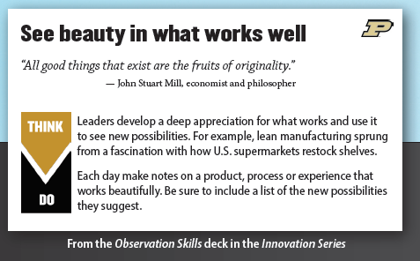
Knowledge cards or kCards work by nudging us daily to experiment with simple but vital behaviors associated with the new skills and habits we want to master.

Slide 5
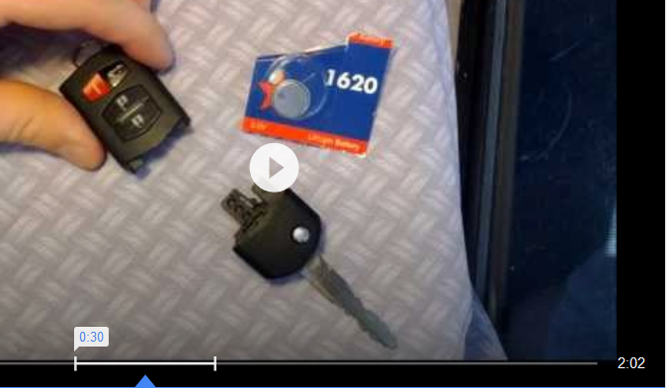
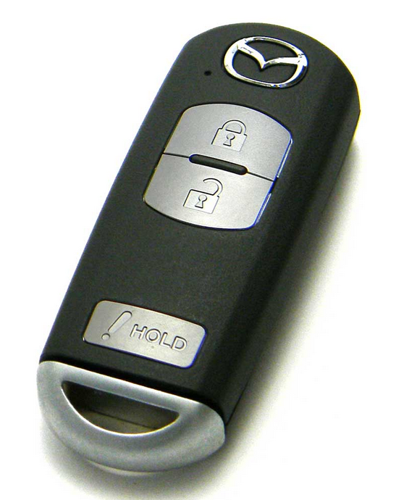

The Accumulation Problem
Design and deliver asynchronous micro content that adds up to macro level habits, competencies and performances over time.
Change out the battery
VS
Design a better Fob
Leaders as design thinkers involves a set of broad competencies

Slide 6
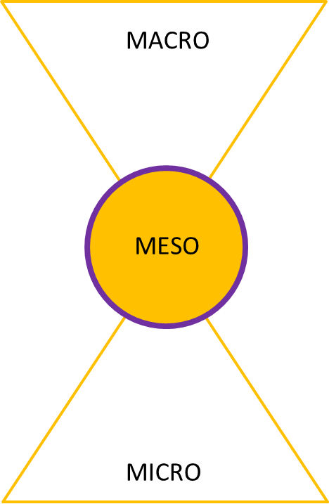
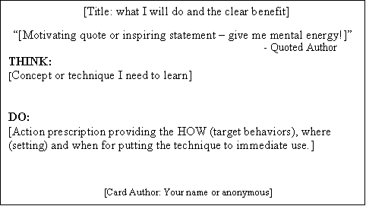
Knowledge Cards
Enable microlearning of new behaviors and soft skill performances from experience
Performance Improvement Goal
Competency Model
The competency models acts as a frame or funnel to insure that each small improvement step accumulates over time into significant new competencies and habits.
Decks
Competency 1
technique 1
-
-
technique N
vital behavior 1
vital behavior 2
-
-
vital behavior N
Knowledge Cards

Slide 7

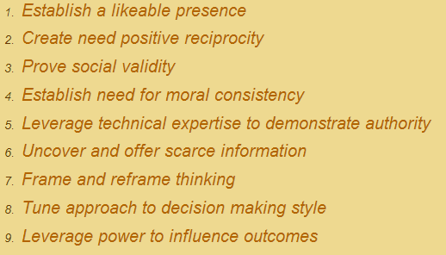
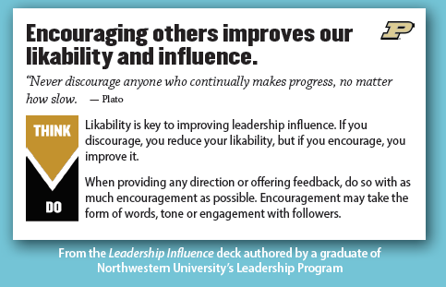
Example: Leadership Influence
“Leadership is a process whereby an individual influences a group of individuals to achieve a common goal. “
Evidence-Based
Competency Model for Influence
Improvement Goal:
Get Better at Influencing Others
438+
Cards

Slide 8
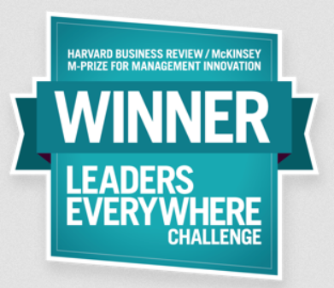

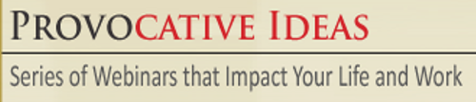

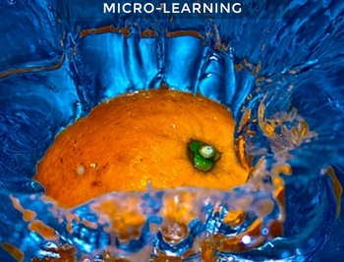

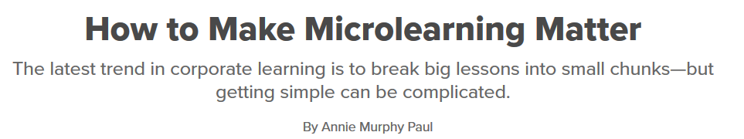


Slide 9
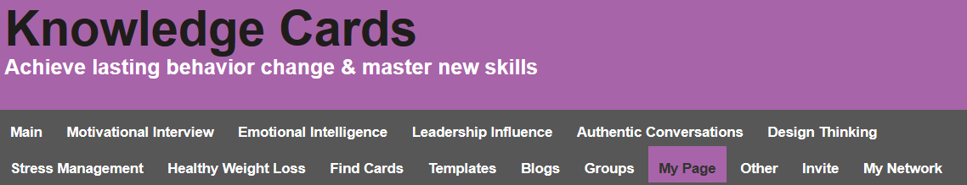


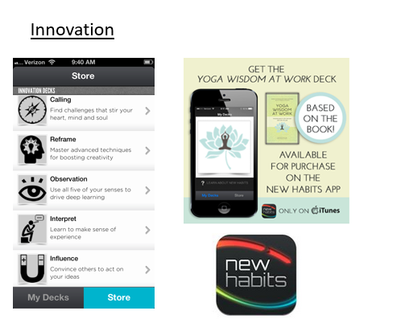
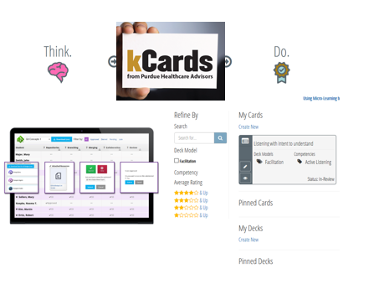
848 Members

Slide 10

Healthcare Leaders Face Soft Skill and Behavior Change Challenges at Multiple Levels
Become a transformational, servant, lean or other type of leader for my facility or system
Move to a team-based collaborative care model
Sustain and spread process improvements
Build a culture of X
Resilient caregivers
Employee health and wellness behaviors
Patient education, experience and engagement
Motivational interviewing
Patient’s self-manage of chronic conditions

Slide 11
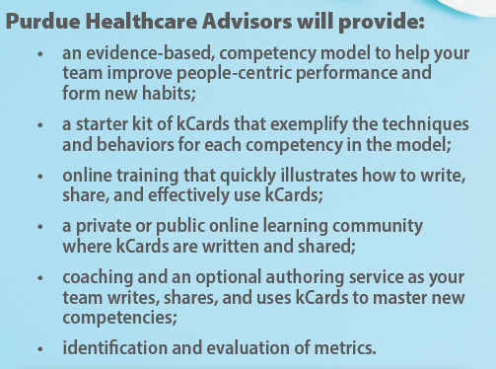
Collaboration Opportunity
Work as a community to develop the knowledge cards to tackle one difficult soft skill and behavior change challenge in healthcare
Purdue will support (at no direct cost) one application for a group of up to 20 hospitals and 250 participants in a 18 month field test
Email or call for further details

